Slide 1
Web Technologies

Slide 2
<header>
Design decisions are important
Includes choosing which technologies to use!
Success or failure of a project often depends on earlier decisions

Slide 3
Languages & Frameworks
Each language has its pros and cons
Each language has frameworks, with their own pros and cons
Try new languages/frameworks periodically!
Plenty of failings exist in PHP, and even more people will tell you about them
Need motivation? Google for some of these flaws.

Slide 4
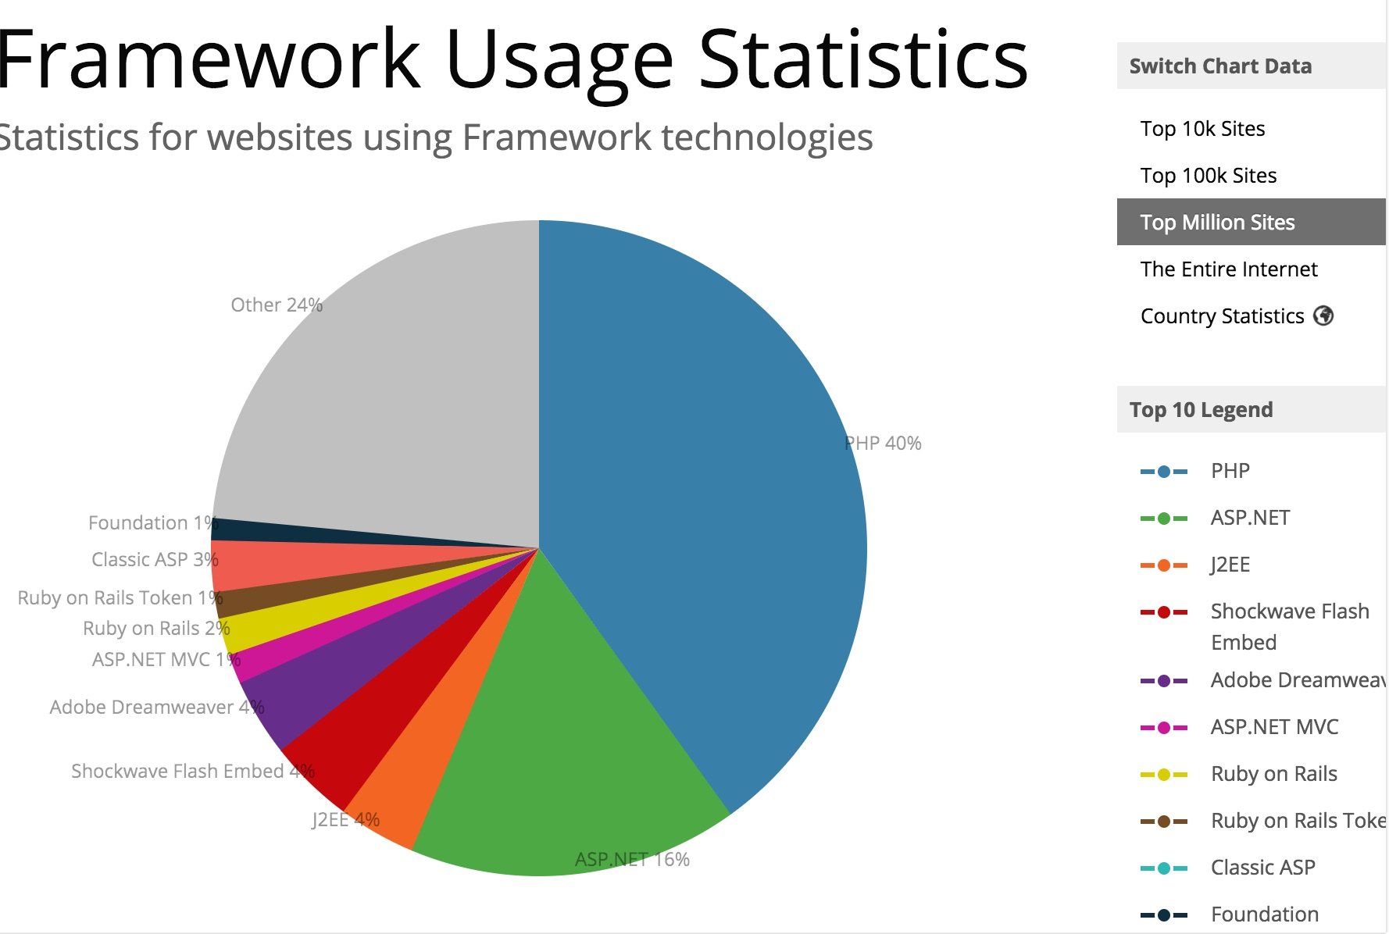
https://trends.builtwith.com/framework

Slide 5
Ruby on Rails http://rubyonrails.org/
Model-View-Controller (MVC) framework for Ruby
Integrated Web server
Don't Repeat Yourself (DRY) philosophy: In software engineering, don't repeat yourself is a principle of software development aimed at reducing repetition of software patterns, replacing it with abstractions or using data normalization to avoid redundancy.

Slide 6
Ruby on Rails http://rubyonrails.org/
Pros:
ReSTful out of the box
Scaffolding code makes CRUD trivial
Database migrations good at controlling schema
Cons
Opinionated
Harder to adapt to non-CRUD features
Steep learning curve for more complex operations

Slide 7

Node.js http://nodejs.org/
Javascript on the server – What?!?
Node.js is an open-source, cross-platform JavaScript run-time environment that executes JavaScript code outside of a browser. Typically, JavaScript is used primarily for client-side scripting, in which scripts written in JavaScript are embedded in a webpage's HTML and run client-side by a JavaScript engine in the user's web browser.
Facilitates an alternative to PHP or a mashup of both : Middle-tier
https://en.wikipedia.org/wiki/Node.js

Slide 8
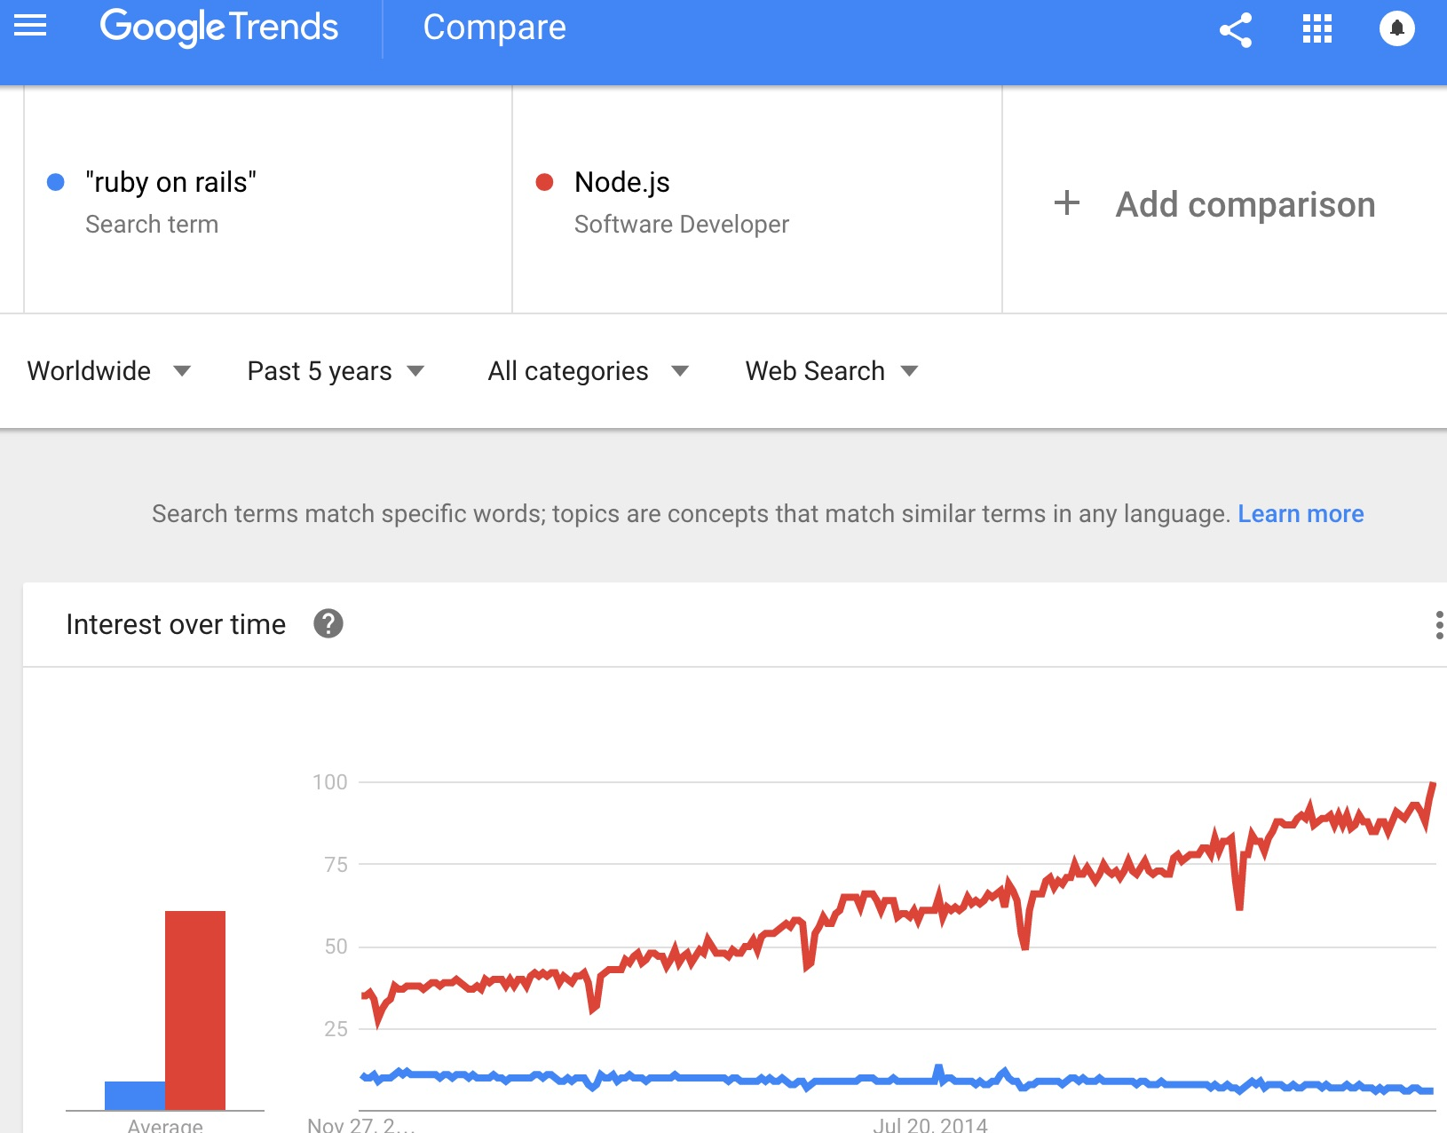
https://www.google.com/trends/explore?q=%22ruby%20on%20rails%22,%2Fm%2F0bbxf89&hl=en-US

Slide 9
Django (web framework) https://www.djangoproject.com/
Python based framework
Javascript on front-end talks to Python on back-end
DRY like Ruby
Django's primary goal is to ease the creation of complex, database-driven websites. The framework emphasizes reusability and "pluggability" of components, less code, low coupling, rapid development, and the principle of don't repeat yourself.
https://en.wikipedia.org/wiki/Django_(web_framework)

Slide 10
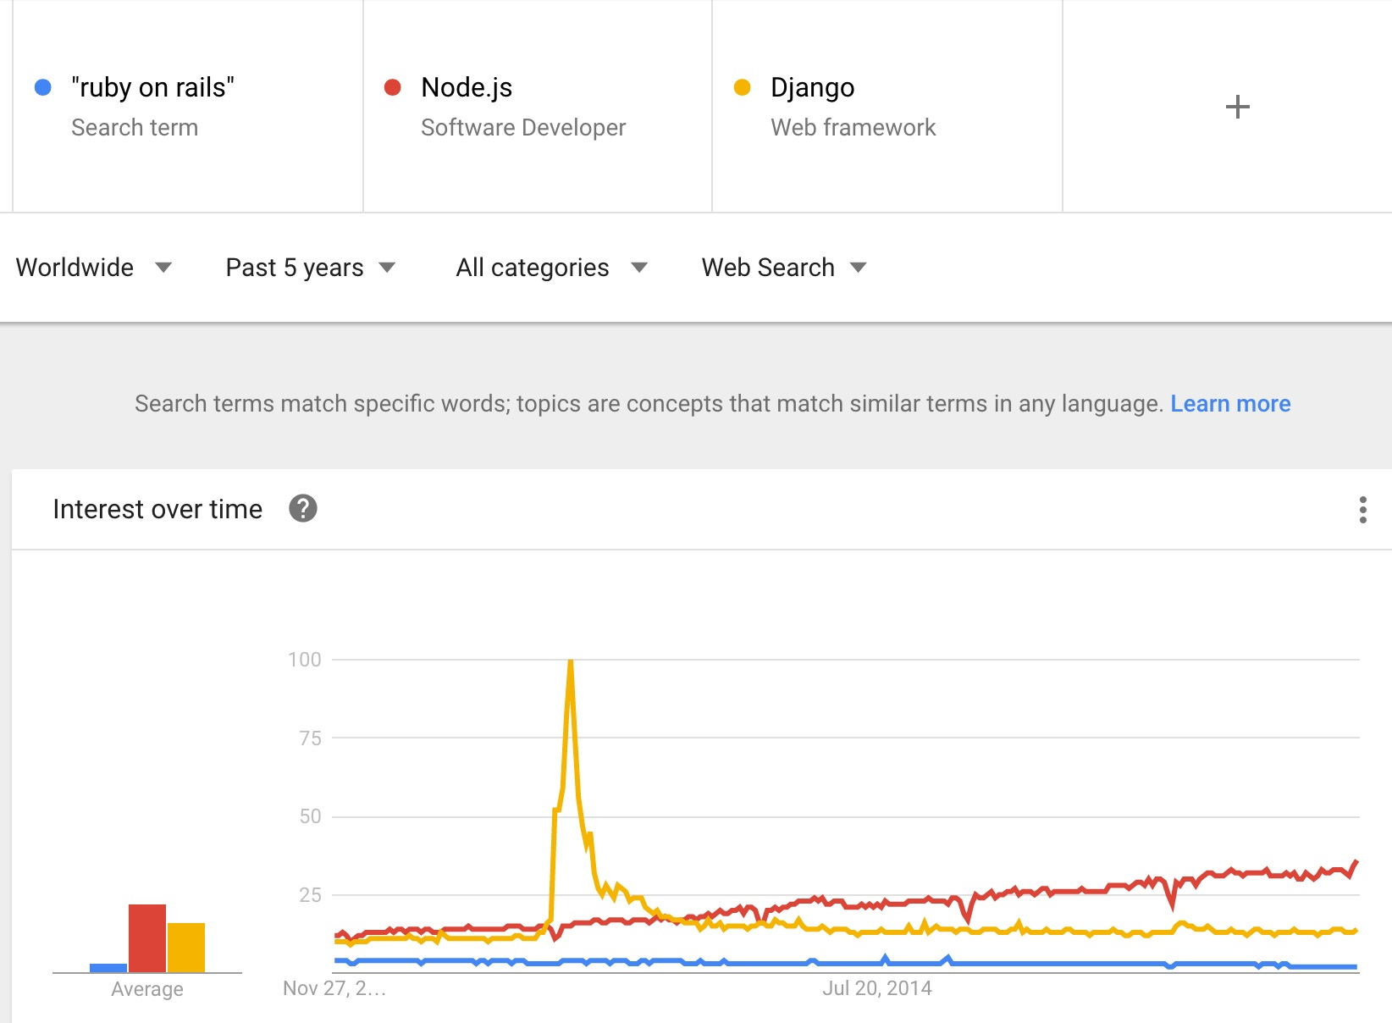
https://www.google.com/trends/explore?q=%22ruby%20on%20rails%22,%2Fm%2F0bbxf89,%2Fm%2F06y_qx&hl=en-US

Slide 11
Java
Backend language – when it comes to the web
(if we do not consider applets & jvm)
jsp are server side even though they are Views
Designed to be portable
Designed to be Object oriented
VERY popular – been around since ~1991

Slide 12
Struts http://struts.apache.org/
Apache project
MVC framework for Java
Extends Java Server Pages (JSP) to provide views
Provides means of controlling config from XML
Built-in form validation
http://struts.apache.org/primer.html

Slide 13

Apache Struts 2
Apache Struts 2 is an open-source web application framework for developing Java EE web applications. It uses and extends the Java Servlet API to encourage developers to adopt a model–view–controller (MVC) architecture. The WebWork framework spun off from Apache Struts aiming to offer enhancements and refinements while retaining the same general architecture of the original Struts framework.
https://en.wikipedia.org/wiki/Apache_Struts_2

Slide 14
Struts http://struts.apache.org/
Pros
Loose coupling of configuration and code
Solid integration with JavaBeans
Built-in form validation
AJAX Support
Cons
Steep learning curve
Dense in magic
Very rigid (good or bad)

Slide 15

Spring MVC http://spring.io/
Like Struts, is Java based
Server side
ReSTful
The Spring Framework is an application framework and inversion of control container for the Java platform. The framework's core features can be used by any Java application, but there are extensions for building web applications on top of the Java EE (Enterprise Edition) platform.
https://en.wikipedia.org/wiki/Spring_Framework

Slide 16
Spring MVC http://spring.io/
Evolved as a need for a better Struts 1 did not accommodate the View very well.
Struts 2 added good view technology (ala webwork2)
So they are similar, however Spring is very popular
Becoming more and more popular

Slide 17
ASP.NET
Active Server Pages
Web framework for Microsoft’s .NET languages
C# , VB, F# etc…
Three means of developing
Web Pages (ala PHP)
MVC Architecture
Event-driven web forms
ASP.NET is an open-source^{[2]} server-side web application framework designed for web development to produce dynamic web pages. It was developed by Microsoft to allow programmers to build dynamic web sites, web applications and web services.
https://en.wikipedia.org/wiki/ASP.NET

Slide 18
ASP.NET
Pros
Can use any .NET language
Extensive library of reusable components
UI
Auth
Manage states behind the scenes
Cons
Abstract
Learning curve
Not Open – Very – Microsoft (good or bad)

Slide 19
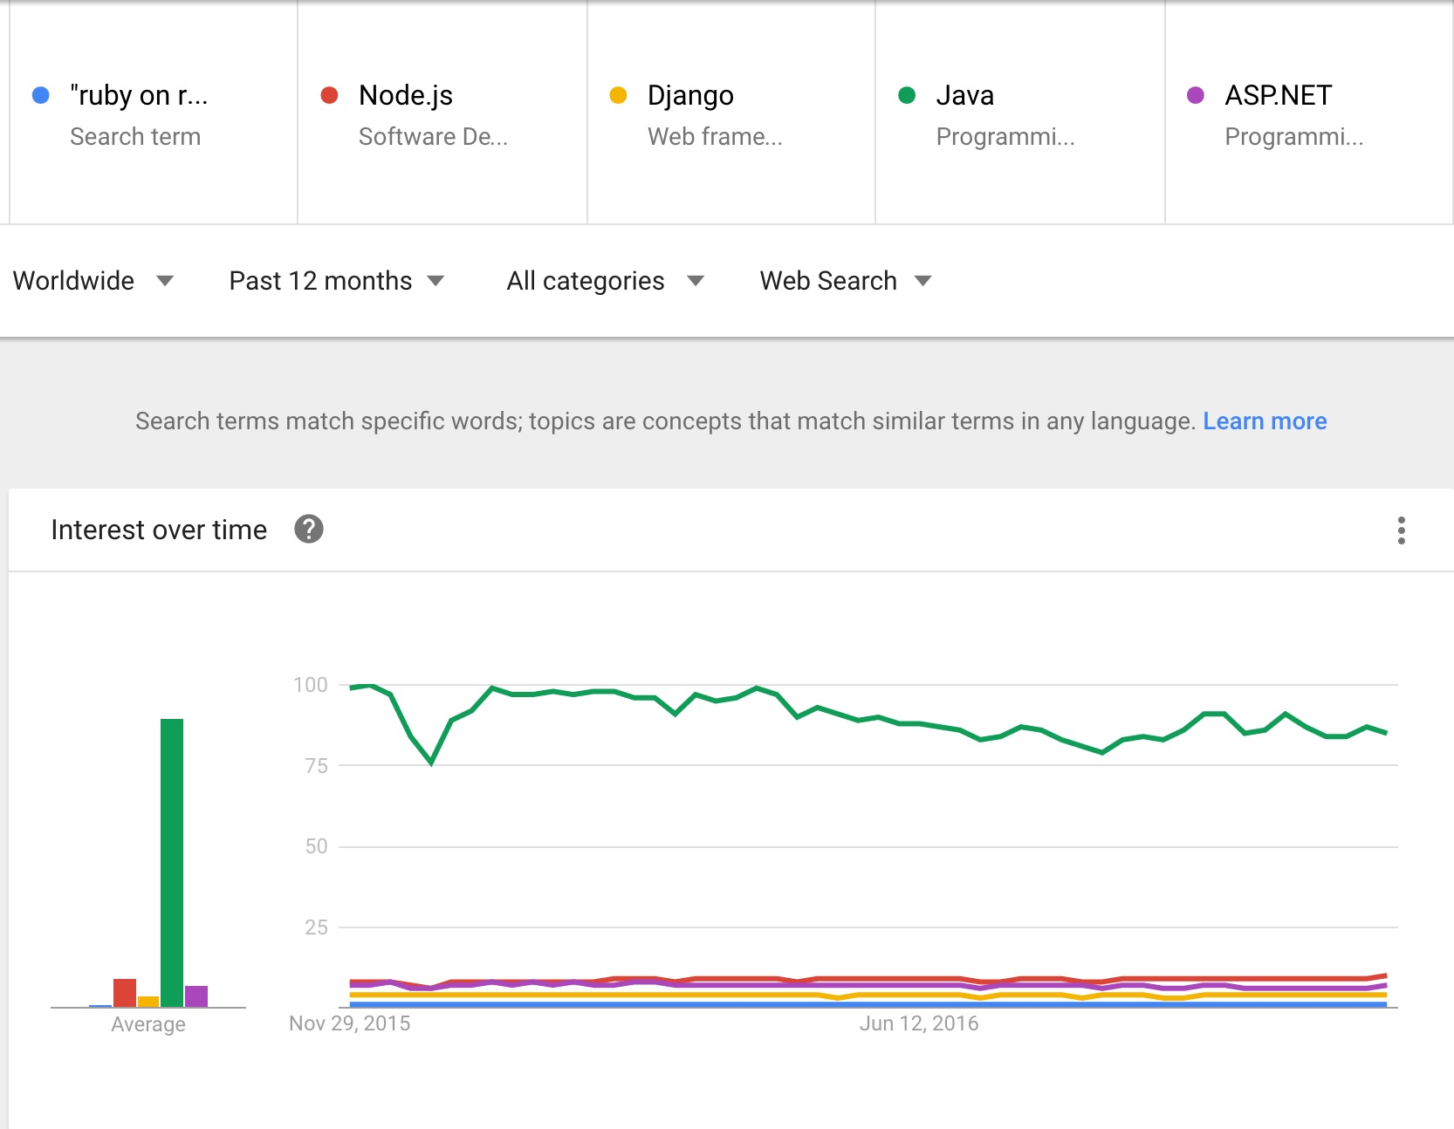
https://www.google.com/trends/explore?date=today%2012-m&q=%22ruby%20on%20rails%22,%2Fm%2F0bbxf89,%2Fm%2F06y_qx,%2Fm%2F07sbkfb,%2Fm%2F02_qnn&hl=en-US

Slide 20
Database Systems
Relational databases have been the norm
Some disadvantages despite popularity

Slide 21
Database Systems
MySQL
PostgreSQL
MariaDB (similar to MySQL and open source)
MongoDB
Hadoop (for Big Data)

Slide 22
Other Relational Databases
Open
MySQL & its forks – MariaDB
PostgreSQL
Proprietary
DB2
Oracle
SQL Server
MySQL - now

Slide 23
<aside> ACID
Atomicity – Each transaction succeeds, or fails to an unchanged state
Consistency – State changes are always valid and within constraints
Isolation – Transactions must not interfere with each other
Durability – Fault-tolerance after a failed transaction

Slide 24
NoSQL Databases
A class of DBMS
Non-relational
Don’t use SQL
Not necessarily ACID compliant
Trade off data integrity in favor of scalability/performance
Usually supports distributed architecture
MongoDB, XML, BigTable, etc…

Slide 25
Object Oriented Databases
Not to be confused with object-relational mapping
Data model represented as objects
Tight integration with OOP
Supports the notions of encapsulation, inheritance, polymorphism, etc
Uses Object Query Language (OQL)

Slide 26
Object Oriented Databases
Pros
No need to translate the data model to OOP
Objects only need to be created and accessed once
Allows for easier representation od heirarchy
Cons
Low degree of adoption – started in the 70s
Less efficient for simple data models
Used in telecomm and molecular biology

Slide 27
Document-oriented Databases aka semi-structured data
type of NoSQL
MongoDB
Key-value stores (value is the document)
Keys are usually indexed for fast reads
Documents may have loosely defined fields (vaguely similar to columns)
No strict schema
Often stored in a semi-consistent format (eg something JSON-esque)

Slide 28
Decisions, Decisions
Certain tools are better suited to solving certain types of problems
Know your tools
Constantly add new tools
Use the right tool for the job

Slide 29
Ex: Content Management
Content Management
Manage content at a (usually) document level
Documentum
Sharepoint
Component Content Management
Manages content at a more granular level
DocuBuilder
Web Content Management

Slide 30
Web Content Management
A CMS that is web-based and
Provides a means of editing and storing content
Offers some sort of publication workflow
Used for Website authoring and management
Not all CMS are created equal

Slide 31
WordPress
Started in 2003
Written in PHP
Available as PaaS to host blogs
www.wordpress.com
Available as software to install and run on your own
www.wordpress.org

Slide 32
WordPress site architecture
Template-driven (highly)
Look & feel of each page
Modular - a page contains files like:
index.php
header.php
sidebar.php
footer.php
A template file can generate content from the MySQL database
Plugins available to extend the core functionality
PostgreSQL

Slide 33
Strengths
Theming is very straightforward
Many themes to choose from
Simple authentication/Authorization
Quick turn-up time
Great for Blogs – very blog-centric
Free
Open-source
Many plugins available

Slide 34
Weaknesses
Not easy to manage complex user permissioning
Not useful for complex e-commerce
Multi-currency, multi-payment, etc
Not suited to non-CMS related content/sites

Slide 35

Drupal
First release in January 2001
Written in PHP
Equal parts content management system (for users) and content management framework (for devs)
Hosted solutions now exist via Drupal Gardens, et al
Mostly self-hosted
https://en.wikipedia.org/wiki/Drupal

Slide 36
Drupal Architecture
Modules extend the functionality of Drupal core
Themes provide templates/CSS for creating visually consistent output
Installation profiles group modules and themes together
Distributions (forks) of Drupal exist for specific types of sites

Slide 37
Drupal Strengths
Highly extensible
Robust permissioning
Data model is more flexible – dictated by admin
More robust offering
Ie – e-commerce
Drupal provides a back-end framework for at least 2.3% of all web sites worldwide^{[8][9]} – ranging from personal blogs to corporate, political, and government sites.^{[10]} Systems also use Drupal for knowledge management and for business collaboration
https://en.wikipedia.org/wiki/Drupal

Slide 38
Drupal Weaknesses
Contributed module overload
Lots of overhead for smaller sites
Steep learning curve

Slide 39
Which to Choose?
Depends on the problem!
Blogs – WordPress
Advanced content types, extensibility - Drupal

Slide 40
Build or Buy
Important decision for new projects
Build a new solution from scratch?
...Or use/modify one that already exists?
Everything has a price
Even Free & Open Source Software (FOSS) solutions have a cost!

Slide 41
Build or Buy
Problem Set
Security
Cost (Direct/Indirect)
Hidden Costs
Time
Support
Barriers to adoption
Familiarity
Scalability
etc...

Slide 42
Which to choose?
It depends
Which solution is best given your constraints?
Everything is a tradeoff – what is your best formula?
Get second opinions – solicit opinions
Just because we ‘can’ doesn’t mean we ‘should’
But is doesn’t mean we ‘shouldn’t’ either
Remember Murphy’s Law:
If anything can go wrong, it will!
But don’t panic – you can handle it!

Slide 43
Which to choose?
In the end;
Make the best choice you can with the information and constraints you have had to deal with and move forward
The worst thing you can do is NOT make a decision
We learn from our mistakes and we adapt
You know this stuff –
Analyze, Evaluate, Decide and you will conquer!

Slide 44
<footer>
It’s Pleasure to Teaching you All !!!

Slide 45
</class> </lectures>

